Slide 1



Slide 2
Software Requirements Specification

Slide 3
Automated Record & Management System

Slide 4
Prepared by
Capt Abdur Rehman Raza Khan
Cpl Zeeshan Mubarak
GC Najeeb ur Rehman

Slide 5


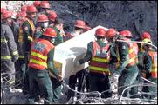
Rescue

Slide 6
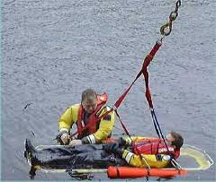
Rescue refers to responsive operations

Slide 7

Rescue refers to responsive operations that usually involve the saving of life,

Slide 8

Rescue refers to responsive operations that usually involve the saving of life, or prevention of injury

Slide 9

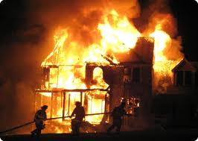
Rescue refers to responsive operations that usually involve the saving of life, or prevention of injury during an incident or dangerous situation.

Slide 10

Rescue 1122

Slide 11

Rescue 1122
established in

Slide 12

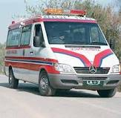
Rescue 1122
providing timely response, rescue and emergency medical treatment to the persons affected by emergencies.

Slide 13

Rescue 1122
providing timely response, rescue and emergency medical treatment to the persons affected by emergencies.

Slide 14
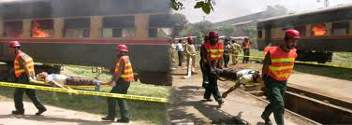
Rescue 1122
providing timely response, rescue and emergency medical treatment to the persons affected by emergencies.

Slide 15

Rescue 1122
All system is mannual

Slide 16
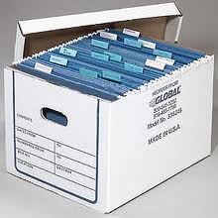
Rescue 1122
Maintaining Records

Slide 17

Rescue 1122
Reports

Slide 18

Rescue 1122
Crew Management

Slide 19

Rescue 1122
Leads To

Slide 20

Rescue 1122
Thousands of Files

Slide 21

Rescue 1122
Hard to Maintain

Slide 22

Rescue 1122
Too much work load

Slide 23

Rescue 1122
Hard to Search

Slide 24

Rescue 1122
Late Response

Slide 25
Purpose of presntation
The purpose of presentation is to give a detailed description of SRS on Automated Record & Management System for the Rescue 1122.

Slide 26
Table of Contents
Introduction
Overall description
Use Cases

Slide 27

Introduction

Slide 28


Purpose

Slide 29
Purpose
The purpose of this document is to present a detailed description of Automated Record & Management System for the Rescue 1122.

Slide 30


Purpose
It will explain the
purpose and features of the system

Slide 31

Purpose
It will explain the
the interfaces of the system

Slide 32

Purpose
It will explain the
what the system will do

Slide 33
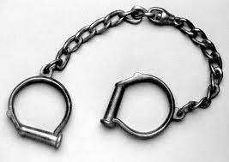
Purpose
It will explain the
the constraints

Slide 34

Purpose
It will explain the
Document is intended for
developers

Slide 35

Purpose
It will explain the
Document is intended for
project managers

Slide 36

Purpose
It will explain the
Document is intended for
users

Slide 37

Purpose
It will explain the
Document is intended for
software test engineers.

Slide 38

Project Scope
The product provides:
Status of Emergency & Crews
Automated Records
Crew Management
Quick Response
Reports Generation
Central Authentication
LAN Connectivity

Slide 39
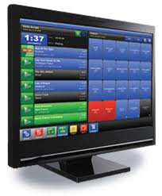
Project Scope
The product provides:
Status of Emergency & Crews
Automated Records
Crew Management
Quick Response
Reports Generation
Central Authentication
LAN Connectivity

Slide 40

Project Scope
The product provides:
Status of Emergency & Crews
Automated Records
Better Crew Management
Quick Response
Reports Generation
Central Authentication
LAN Connectivity

Slide 41

Project Scope
The product provides:
Status of Emergency & Crews
Automated Records
Crew Management
Quick Response
Reports Generation
Central Authentication
LAN Connectivity

Slide 42

Project Scope
The product provides:
Status of Emergency & Crews
Automated Records
Crew Management
Quick Response
Reports Generation
Central Authentication
LAN Connectivity

Slide 43

Project Scope
The product provides:
Status of Emergency & Crews
Automated Records
Crew Management
Quick Response
Reports Generation
Central Authentication
LAN Connectivity

Slide 44

Project Scope
The product provides:
Status of Emergency & Crews
Automated Records
Crew Management
Quick Response
Reports Generation
Central Authentication
LAN Connectivity

Slide 45
Overall Description

Slide 46
Product Perspective
The ARMS is a replacement of existing system. The existing system maintains the data on registers and all the staff within offices has to inform each other through telephone or personally about some emergency. The product will enable the staff i.e (Control Room Wireless Operator, Crew Manager, Station Incharge) to remain in picture what activity is going on and provide better management of crew. The response time to the emergency will decrease which will ultimately benefit the general public.

Slide 47
Product Functions
Following are product main Functions:-
Data Management
Initial info record
Detailed Emergency Report
Remarks of Station Incharge
Crew Management
Status of Emergency
Status of Crew
Report Generation
Search

Slide 48
User Classes
Control Room Wireless Operator
It receives the phone calls for emergency and fills the initial emergency request form. Generally Two types of Calls
Request for Emergency
Request for Additional Crew
Crew Manager
When an initial request form is filled, Crew manager assigns the crew based on nature of emergency.
Crew Informer
When some crew is assigned for some emergency dealing, it sends them to the location of emergency. And fills out the time of leaving the garage and time of reporting back from the emergency.

Slide 49
User Classes
Station Incharge
It is overall supervisor of a rescue 1122 station. He manages the reports and supervises all the staff.
Crew
Crew deals with emergency physically by going on location. On completion, crew fills out detailed report about the emergency. Crew consists of
Medical officer
Rescue 1122 Staff(driver, helper, rescuer)
Nursing Staff
General Public
Gets benefits in terms of early response

Slide 50
Constraints
Constraints | Rationale
Microsoft Windows | The users have prior experience of using this operating system.
The system coding will be done in C# language with object-oriented methodology. | C# is a powerful high level language by Microsoft. Support of large .Net Library enhances its capability and makes it suitable for Desktop software.

Slide 51
Constraints
Constraints | Rationale
Microsoft SQL Server | Its integration with Windows OS is easy and stable. It provides efficient and reliable database operation and accommodates fairly large numbers of records.
LAN | Since all the users of the system reside in one building and all the data is to be maintained on one central database

Slide 52
Specific Requirements

Slide 53
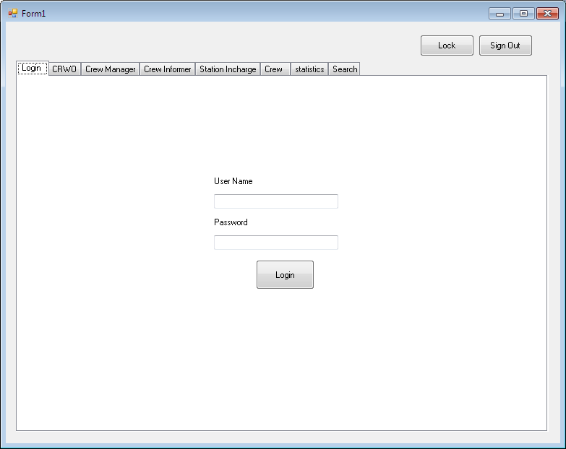
User Interfaces

Slide 54
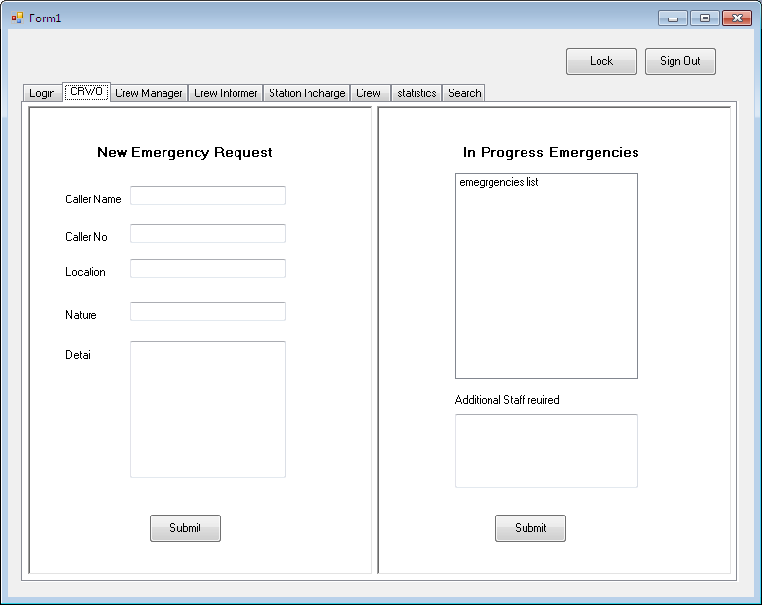
User Interfaces

Slide 55
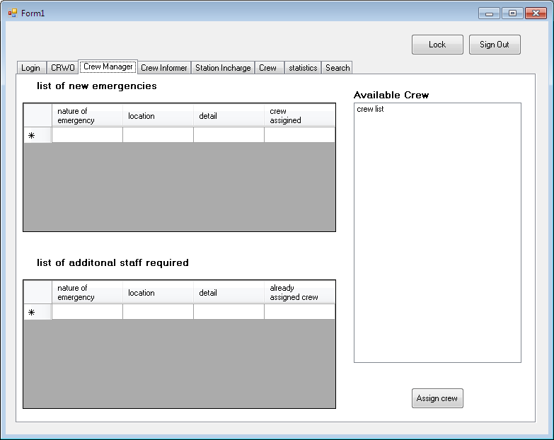
User Interfaces

Slide 56
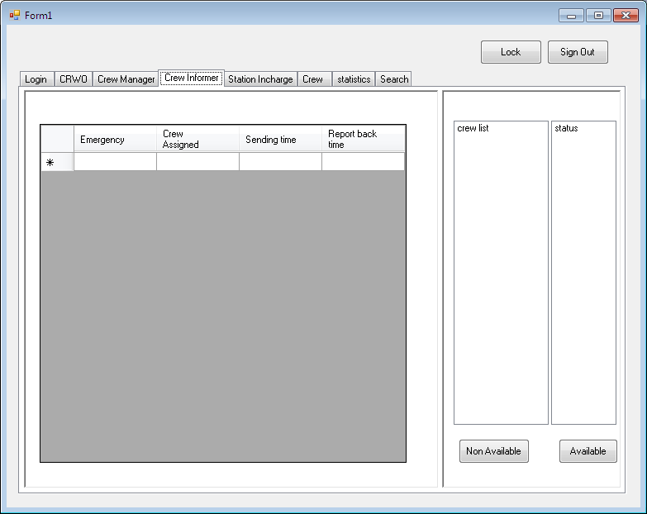
User Interfaces

Slide 57
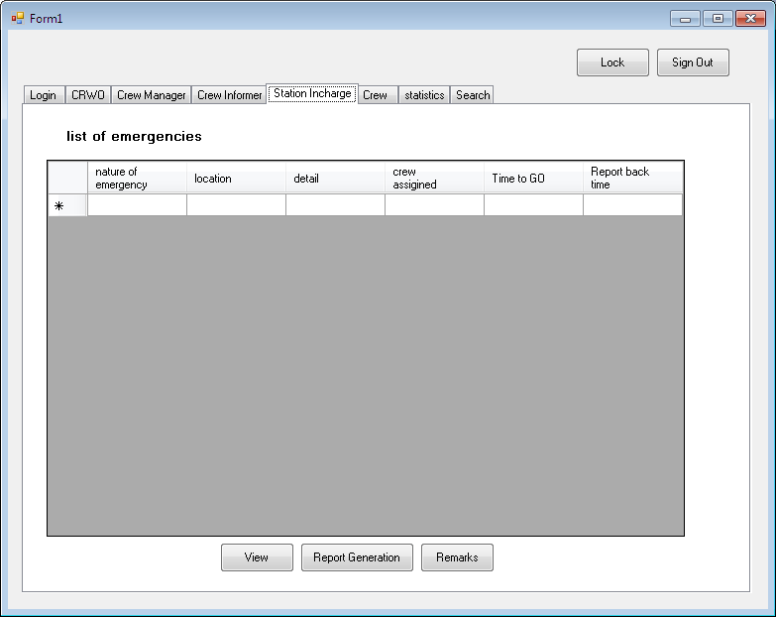
User Interfaces

Slide 58
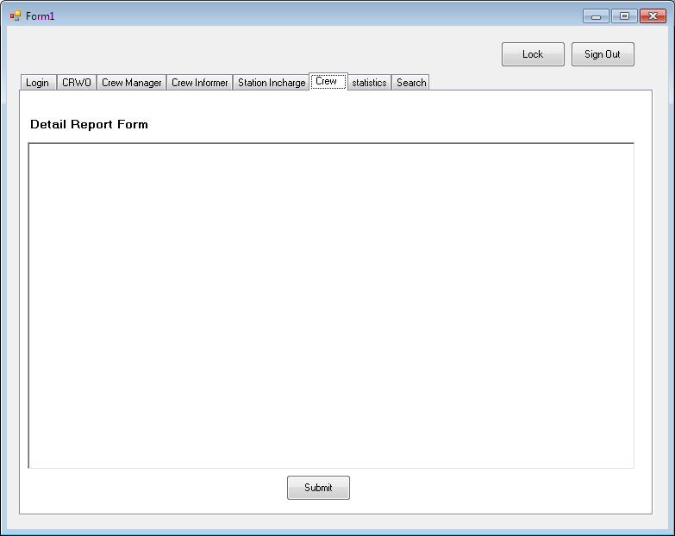
User Interfaces

Slide 59
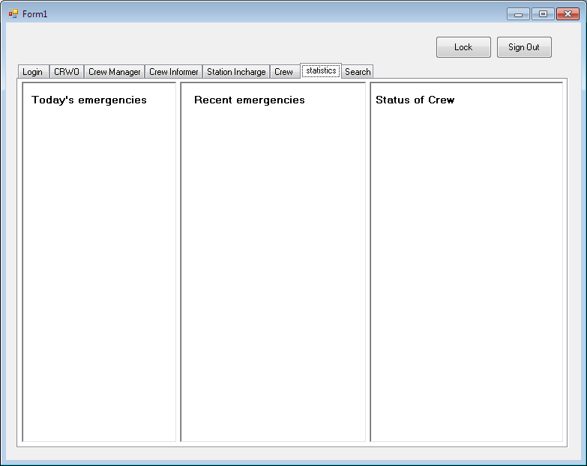
User Interfaces

Slide 60
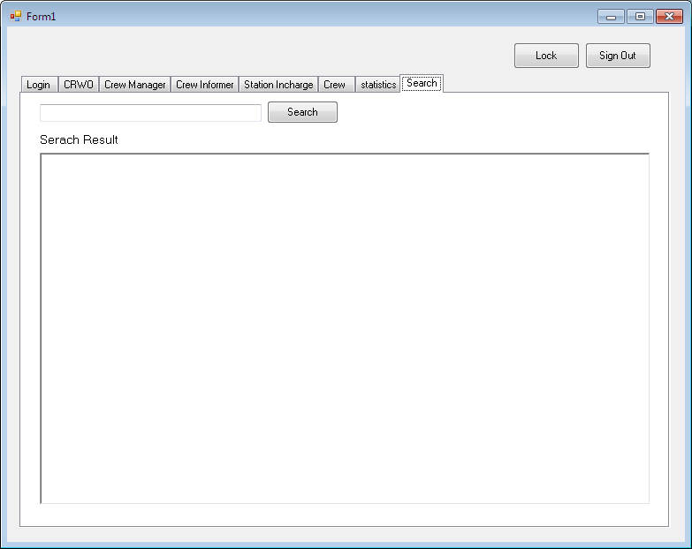
User Interfaces

Slide 61
Control Room Wireless Operator USE Case
1-Request For Emergency Rescue
Brief Description
The Control Room Wireless Operator on receiving the call of new emergency fills out initial information.
Initial Step-By-Step Description
Before this use case can be initiated, the CRWO has to be logged in as CRWO so that he can get associated interface to fill initial information.
The CRWO on receiving the call click on new emergency button
The System gives initial information form.
The CRWO fills the form and click on submit.
The Request handler insert the data into database.
On completion, Successful insertion message is displayed
The CRWO is returned to main page.

Slide 62
Control Room Wireless Operator USE Case
2-Additional Crew Request
Brief Description
The Control Room Wireless Operator on receiving the call for additional crew initiate the request.
Initial Step-By-Step Description
Before this use case can be initiated, the CRWO has to be logged in as CRWO so that he can get associated interface.
The CRWO on receiving the call click on Additional Crew Request Button.
The System provides the list of in progress emergencies.
The CRWO selects the emergency for which additional crew request was asked.
The System provides the view which shows the details of staff already sent for that emergency.
The CRWO writes the detail of additional requested crew.
The CRWO submit the details.
The Request Handler modifies the record of that particular emergency.
On completion, Successful insertion message is displayed.
The CRWO is returned to main page.

Slide 63
Crew Manager USE Case
1-Assign Crew to Emergency
Brief Description
When so ever the new Emergency form is submitted by the CRWO Crew Manager Assigns the crew to emergency based upon the nature of emergency.
Initial Step-By-Step Description
Before this use case can be initiated, the CREW manager has to be logged in as Crew Manager so that he can get associated interface.
The System provides the crew manager with a blank interface.
When so ever the CRWO submit the request for crew, the view is updated and detail of emergency is provided.
Crew Manager reads the details and assign the crew from list of available crew
On completion, Successful message is displayed
In case no crew is free, Crew Manager is provided with the list of all the crews and their nature of emergency.
Then Crew manager assigns the crew which is expected to fall back soon.
The crew manger is returned to main page.
Request Handler keep track of assigning of crew. If the assigned crew doesn’t come back soon and some other crew has returned, crew manager is alerted so that he can reassign the crew.

Slide 64
Crew Manager USE Case
2-Additional Crew Request
Brief Description
When so ever the request for additional crew is submitted by the CRWO, Crew Manager Assigns the crew.
Initial Step-By-Step Description
Before this use case can be initiated, the CREW manager has to be logged in as Crew Manager so that he can get associated interface.
The System provides the crew manager with a blank interface.
When so ever the CRWO submit the request for additional crew, the view is updated and detail of emergency is provided.
Crew Manager reads the details and assign the crew from list of available crew
On completion, Successful message is displayed
In case no crew is free, Crew Manager is provided with the list of all the crews and their nature of emergency.
Then Crew manager assigns the crew which is expected to fall back soon.
The crew manger is returned to main page.
Request Handler keep track of assigning of crew. If the assigned crew doesn’t come back soon and some other crew has returned, crew manager is alerted so that he can reassign the crew.
The CRWO is returned to main page.

Slide 65
Crew Manager USE Case
2-Additional Crew Request
Brief Description
When so ever the request for additional crew is submitted by the CRWO, Crew Manager Assigns the crew.
Initial Step-By-Step Description
Before this use case can be initiated, the CREW manager has to be logged in as Crew Manager so that he can get associated interface.
The System provides the crew manager with a blank interface.
When so ever the CRWO submit the request for additional crew, the view is updated and detail of emergency is provided.
Crew Manager reads the details and assign the crew from list of available crew
On completion, Successful message is displayed
In case no crew is free, Crew Manager is provided with the list of all the crews and their nature of emergency.
Then Crew manager assigns the crew which is expected to fall back soon.
The crew manger is returned to main page.
Request Handler keep track of assigning of crew. If the assigned crew doesn’t come back soon and some other crew has returned, crew manager is alerted so that he can reassign the crew.
The CRWO is returned to main page.

Slide 66
Crew Manager USE Case
3-View Remarks
Brief Description
When emergency is Completed, SI writes the remarks about the emergency handling procedure.
Initial Step-By-Step Description
Before this use case can be initiated, the CREW manager has to be logged in as Crew Manager so that he can get associated interface.
The System provides the crew manager with the list of today’s emergencies.
If SI writes remarks on some emergency, the view is updated
Crew Manager selects the emergency and click it to view remarks
Remarks are shown
Emergency is marked as read.

Slide 67
Crew Informer Use Case
1-Send Crew
Brief Description
When so ever a Crew is assigned to some emergency, crew informer sends the crew to location.
Initial Step-By-Step Description
Before this use case can be initiated, the Crew informer has to be logged in as Crew Manager so that he can get associated interface.
The System provides the crew informer with interface which contains list of all the crews.
When so ever some crew is assigned, the crew informer view is updated.
Crew informer reads out the details and sends the crew to location.
Crew informer fills in the time for departure and submit.
On completion, Successful message is displayed

Slide 68
Crew Informer Use Case
2-Report Arrival Back
Brief Description
When so ever a Crew is back from some emergency, crew informer fills the arrival back time.
Initial Step-By-Step Description
Before this use case can be initiated, the Crew informer has to be logged in as Crew Manager so that he can get associated interface.
The System provides the crew informer with interface which contains the list of all the crews.
When so ever some crew is back, the crew informer fills the report back time
Crew informer submits the data
On completion, Successful message is displayed

Slide 69
Station Incharge USE Case
1-View Emergency Handling Procedure
Brief Description
Station Incharge views the emergency handling procedure to keep check on performance.
Initial Step-By-Step Description
Before this use case can be initiated, the Station Incharge has to be logged in as Station Incharge so that he can get associated interface.
The System provides the Station Incharge request for emergency procedure view.
The System Provides list of current date all completed Emergencies and a search box to search back date events.
Station incharge clicks on some current date emergency or search for some back date.
Station Incharge is provided with a view of details of the emergency handling.
On clicking back page Button Station Incharge return to his main page.

Slide 70
Station Incharge USE Case
2-Report Generation
Brief Description
Station Incharge views the emergency handling procedure to write report about it.
Initial Step-By-Step Description
Before this use case can be initiated, the Station Incharge has to be logged in as Station Incharge and view some emergency handling procedure.
After viewing emergency handling Procedure, SI click on Write Report Button
SI is provided with report writing view.
SI writes the report and submit it.
On submission Station Incharge return to his main page.

Slide 71
Station Incharge USE Case
3-Remarks
Brief Description
Station Incharge views the emergency handling procedure to write his observations and remarks about the procedure adopted.
Initial Step-By-Step Description
Before this use case can be initiated, the Station Incharge has to be logged in as Station Incharge and view some emergency handling procedure.
After viewing emergency handling Procedure, SI click on Write Remarks Button
SI is provided with remarks writing view.
SI writes the remarks and observations and submit it.
On submission Station Incharge return to his main page.

Slide 72
Crew Use Case
Brief Description
On coming back from emergency, the crew leader needs to report back the details of emergency handling procedure, medical aid provided, store used.
Initial Step-By-Step Description
Before this use case can be initiated, the Crew has to be logged in so that appropriate view can be provided.
Crew Leader is provided with the list of all emergences he has handled and yet not written the detailed report.
Crew Leader writes the report and submit it.
On submission Crew Leader is returned to his main page.

Slide 73
Performance Requirements
The System shall be ready to use within 5 seconds of the launch.
The System shall complete search in 1000 records within 2 seconds.
The System shall update user view within 2 seconds of data change in database.
The system shall generate an error message if connection to database fails prolong more than 10 seconds.
Statistical Report generation shall take less than 15 seconds for 98% of the cases.

Slide 74
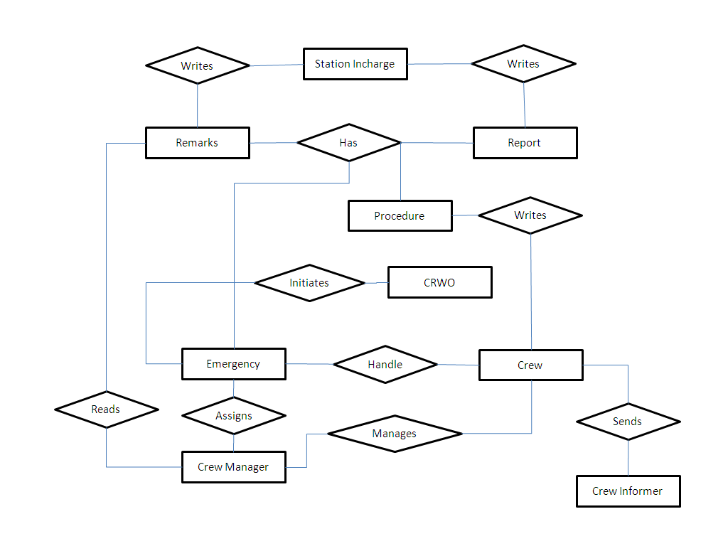
Logical Database Requirements (ER Diagram)

Slide 75
Design Constraints
The communication between UI and database shall be by SQL query.
Transfer of Data shall be over TCP stream.
The source code must follow coding conventions
Update operation shall be a stored procedure

Slide 76
Software System Quality Attributes
Reliability. No more than 1 per 10000 update shall result in a failure requiring a system restart.
Robustness. The system shall restart and start functioning within 15 seconds after crash
Availability. The system shall not be unavailable more than 10 minutes for 100 hour of operation.
Security. After 3 simultaneous login attempts with wrong password, system shall stop responding for 5 mins.
Learning. After two hour training session, Number of errors shall not exceed 3 per week.
Maintainability. Installation of new version/Reinstallation shall leave database unchanged.

Slide 77
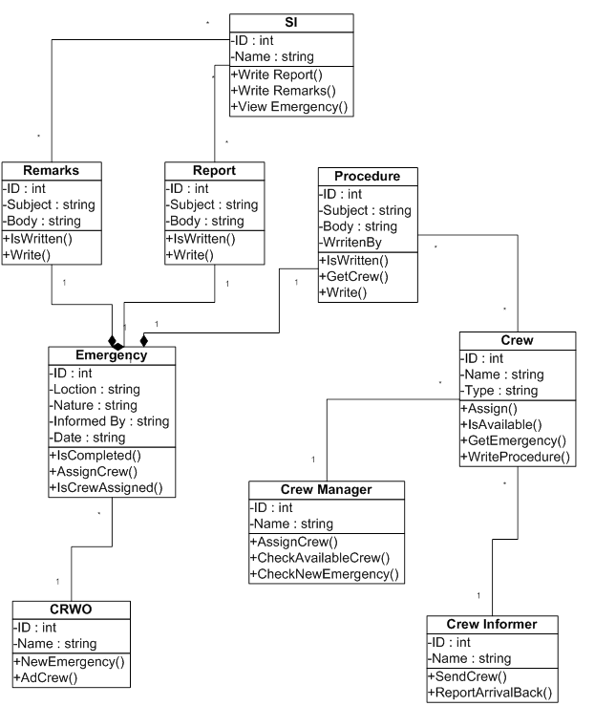
Object Oriented Model (Class Diagram)

Slide 78
Object Oriented Model (Activity Diagrams)

Slide 79
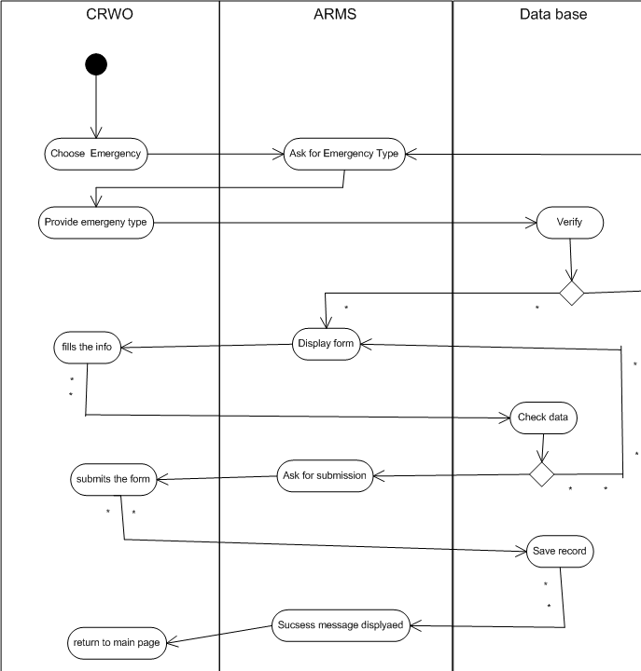

Slide 80
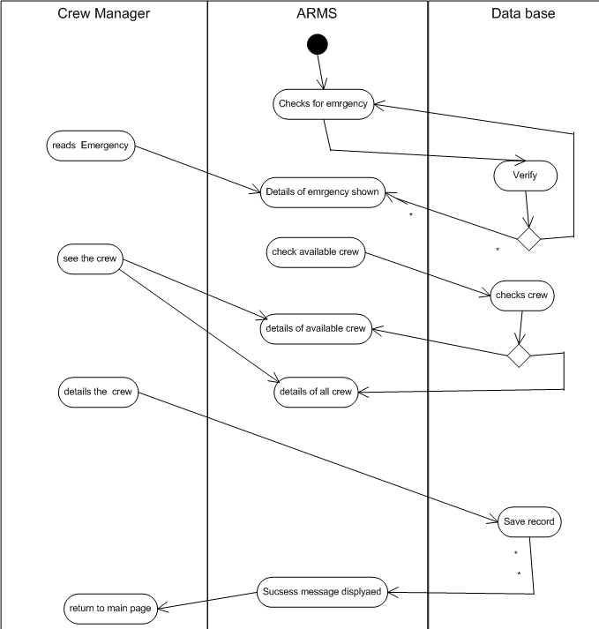

Slide 81
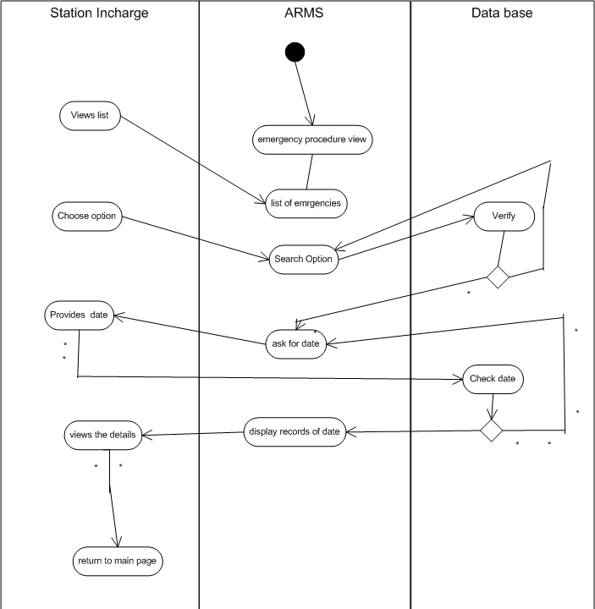

Slide 82
Object Oriented Model (Activity Diagrams)

Slide 83
References
http://wilma.vub.ac.be/~se4_2006/documents/SRS/srs/node1.html
For SRS Pattern and Guideline
http://www.softwarearchitectures.com/go/Discipline/DesigningArchitecture/QualityAttributes/tabid/64/Default.aspx
Software Quality Attributes
http://stackoverflow.com/questions/2231658/what-is-a-logical-requirement
Logical Database Requirements
http://www.smartdraw.com/resources/tutorials/entity-relationship-diagrams/
ER - Diagram

